Slide 1
Social Media Sentiment analysis using Twitter Dataset
BACHELOR OF ENGINEERING
IN
COMPUTER SCIENCE
Submitted by:
TUSHAR SHARMA(20BCS3837)
SACHIN PAREEK(20BCS3817)
AMIT KUMAR (20BCS3767)
Under the Supervision of:
Neeru Bala(E13122)
Department of AIT-CSE
DISCOVER . LEARN . EMPOWER

Slide 2
Outline
Introduction to Project
Design
What inside the project
Implementation
Conclusion and Future Scope
References

Slide 3
Introduction to Project
Social media sentiment analysis is the process of using natural language processing and machine learning techniques to identify and extract subjective information from social media platforms, such as Twitter. Sentiment analysis can provide insights into how people feel about a particular topic, brand, or event, which can be useful for businesses, marketers, and researchers.
Twitter is a popular platform for sentiment analysis due to its large volume of publicly available data and its real-time nature. Researchers and businesses can collect tweets related to a specific topic, brand, or event and use sentiment analysis to analyze the overall sentiment of the tweets.
In this project, we will use a Twitter dataset to perform sentiment analysis. We will collect tweets related to a particular topic, preprocess the data, and use a machine learning algorithm to classify the tweets as positive, negative, or neutral. Finally, we will visualize the results to gain insights into the sentiment of the tweets.

Slide 4

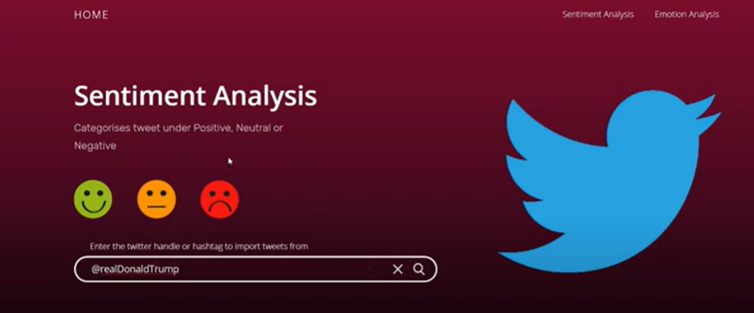
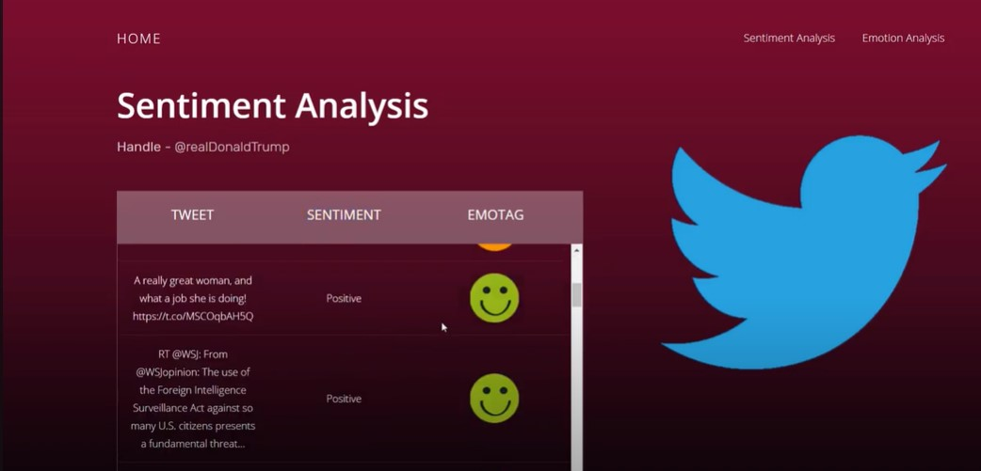
Design
Import Necessary Dependencies
Read and Load the Dataset
Exploratory Data
Analysis Data
Visualization of Target
Preprocessing Splitting our data into Train and Test sets.
Transforming Dataset
Function for Model Evaluation
Model Building
Model Evaluation

Slide 5
What's inside the Project?
First we need to collect data from social media (Tweeter Data).
Processing the data to gain knowledge.(user name, post, comments).
Pre- process the data or clean the data.
Modeling
Reformatting
Now analyze the data and sentiments(Using python command).
After completing above steps we head towards data visualization. Here in we draw inside make dashboard, GUI or any web hosting of results.

Slide 6
Implementation
The implementation of this project is a combination of Python libraries for data analysis, Machine Learning algorithms for tweets classification and EDA tools for dashboards.
The data science project cycle is followed starting from Data Collection, Data Processing, Data Visualization and Data Modelling and Deployment .
As of now, Interactive Dashboards will be the GUI for the system and a dedicated research paper will be written on the methodology followed in it.

Slide 7
Conclusion
A new modern Sentiment Analysis for looking mood and behavior of the person
It describes the need for an analyze the review and thinking for any particular things .
It states the important features that every business have need for growth in their business.

Slide 8
Future Scope
Sentiment analysis will delve deeper, beyond the concept of the number of likes, comments, and shares in a post, to reach and comprehend the significance of social media conversations and what they reveal about consumers.
This academic evaluation will boost the business analytics part of a firm and enable them to make a target audience according to their sentiments and cash-in maximum traffic and profits.

Slide 9
References:
Social Media Sentiment Analysis using Machine Learning : Part — I | by Deepak Das | Towards Data Science
Twitter Sentiment Analysis using Python - GeeksforGeeks
Social Media Sentiment Analysis On Twitter Datasets | IEEE Conference Publication | IEEE Xplore
Twitter sentiment analysis using deep learning methods | IEEE Conference Publication | IEEE Xplore
Advances in Distributed Computing and Artificial Intelligence Journal : 9, Regular Issue 3, 2020 - Ediciones Universidad de Salamanca - Torrossa

Slide 10


